Slide 1
Network Fundamentals Final Exam Information SP5, 2020

Slide 2

General Information
The final exam will be conducted online, in the form of a Learnonline quiz.
Exam date & time: 27 November 2020, starting at 14:00, with a duration of 3 hours, and the session will be unsupervised.
The exam quiz link will be in the top section of Learnonline course site, looking like this:
A week before the exam date, you will be able to see the exam quiz link and the description page of the exam quiz.
Please visit Learnonline course site in the week before the exam to get a clear idea of the location of the exam quiz link and read the exam quiz description. (But please be reminded that you will not be able to access the exam quiz until the start time of the exam, i.e. 14:00 on 27 November 2020.)
The exam is open book. Any printed, handwritten and online materials are allowed, but discussions with others are not permitted during the exam.

Slide 3
General Information
It is important to test your computer and Internet access before the exam date.
Use the link https://my.unisa.edu.au/Public/ComputerSystemTest/learnonline to do the test on the computer you will use during the actual exam and preferably in the location you will do the actual exam.
You can choose the location of where you do the exam. This may be at your home, another suitable venue or you can come to campus. Make sure the venue is quiet, well-lit and ventilated.
If you choose to come to a campus you have the following options:
Computer pools/barns at each campus (not bookable).
Designated quiet spaces in metropolitan campus libraries during the exam period (not bookable).
A limited number of study rooms are available at each metropolitan campus and at Whyalla, and can be booked here: https://my.unisa.edu.au/student/roombookings/studyrooms. Maximum booking periods for study rooms will be extended to 4 hours to accommodate exams.
Spaces at the Mount Gambier campus can be booked by contacting ian.mckay@unisa.edu.au. (if required)
On-campus spaces will not be supervised. If you choose to come on campus, you are encouraged to arrive an hour before your exam is due to start to locate a space and get set up.

Slide 4
General Information
The final exam is worth 30% of the total grade of the course
To pass this course a student must obtain at least 50% in the examination, and at least 50% for the overall assessment.
Refer to Course Outline for the weights (%) for all the assessment items
Check the results available so far, and contact course coordinator and/or your practical supervisor if you think there is an error in the result of an assessment item
Side note:
UniSA Grade system: https://askcampuscentral.unisa.edu.au/app/answers/detail/a_id/3/~/how-is-a-grade-point-average-%28gpa%29-calculated%3F

Slide 5
The Exam
The exam contains two parts:
Part 1: multiple choice questions
Part 2: short answer questions
Part 1 contains 25 multiple choice questions. Some of the questions have only one correct answer while others have more than one. The answers are worth 1 or 2 points. In total, Part 1 is worth 40 points.
Part 2 contains 8 short answer questions. One question may have multiple parts. Marks of questions vary. In total 60 points for Part 2.
The exam quiz will be in the same style/format as the online theory test in Week 12.

Slide 6
The Exam – Part 1
Pick up the best single answer or answers for each question
For a multiple-choice question that has multiple correct answers, full marks will be given when and only when all the correct answers are selected; and the selection of incorrect answers will attract deduction of marks till zero marks are reached for the question.
For a multiple-choice question that has only one correct answer, no marks will be deducted if an incorrect answer is chosen.
Covers all topics, basic concepts mainly
Examples:
What ? Which ? How many ? …
Given a diagram (e.g. a network topology diagram), select the best answer or answers to the question asked that is related to what’s shown in the diagram
Given an IP address, identify relevant information

Slide 7
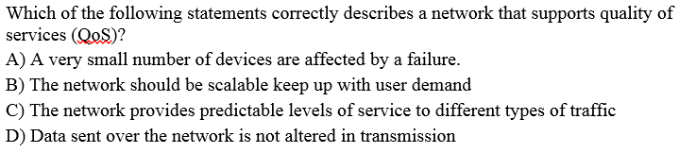
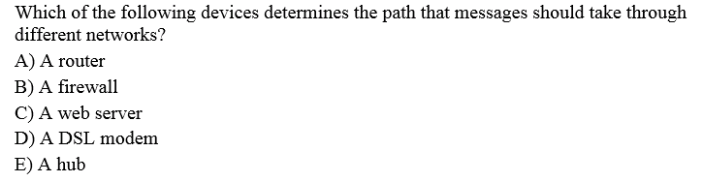
Play slide show to firstly see only the questions before answers (highlighted)
The Exam – Part 1, Sample Questions

Slide 8
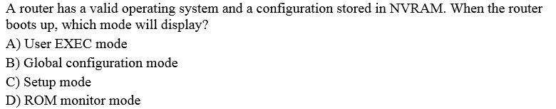
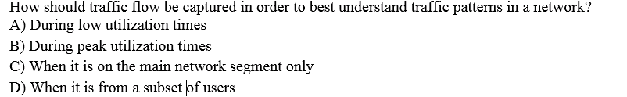
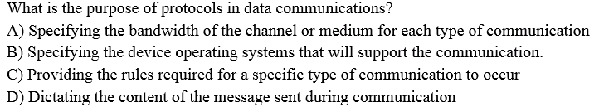
Play slide show to firstly see only the questions before answers (highlighted)
The Exam – Part 1, Sample Questions

Slide 9
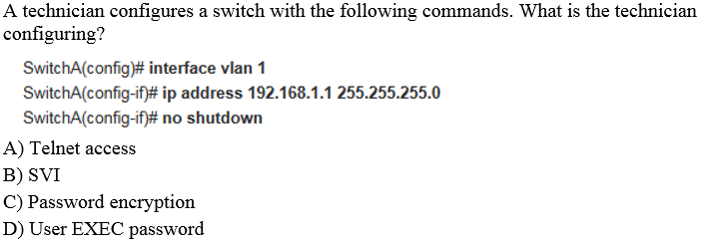
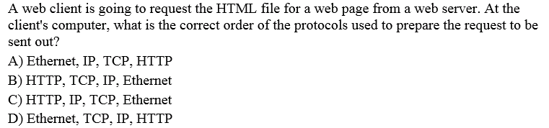
Play slide show to firstly see only the questions before answers (highlighted)
The Exam – Part 1, Sample Questions

Slide 10
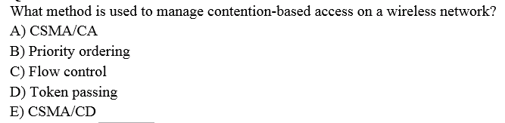
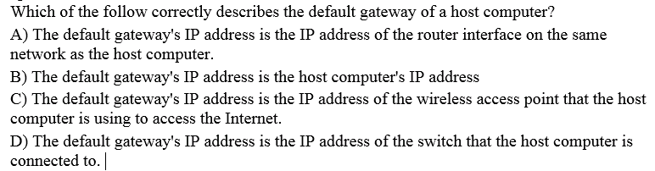
Play slide show to firstly see only the questions before answers (highlighted)
The Exam – Part 1, Sample Questions

Slide 11
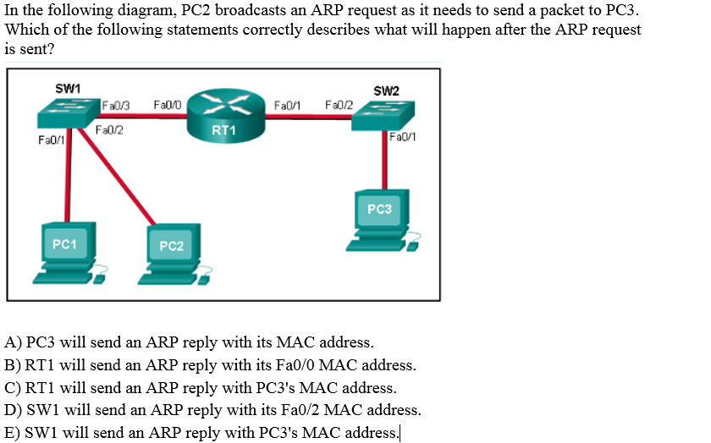
Play slide show to firstly see only the questions before answers (highlighted)
The Exam – Part 1, Sample Questions

Slide 12
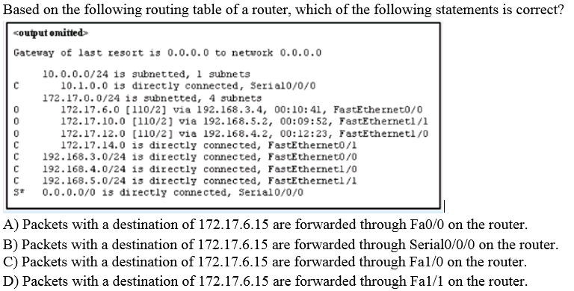
Play slide show to firstly see only the questions before answers (highlighted)
The Exam – Part 1, Sample Questions

Slide 13
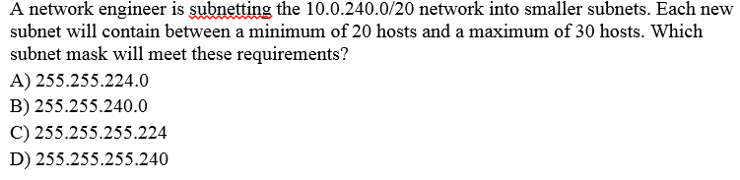
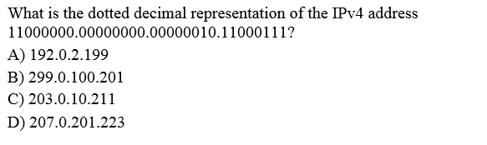
Play slide show to firstly see only the questions before answers (highlighted)
The Exam – Part 1, Sample Questions

Slide 14
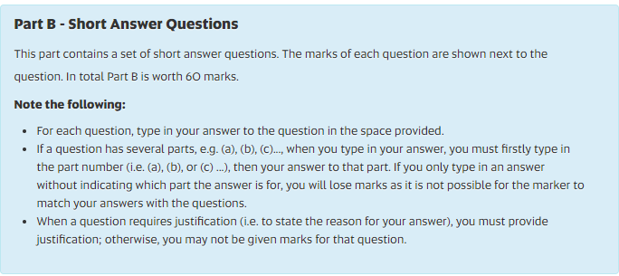
The Exam – Part 2
Screen shot of the description of Part 2 in the real online exam:

Slide 15
The Exam – Part 2, Topics
The questions may be presented in different orders in the exam.
TCP/IP model
Given a scenario, e.g. retrieving a web page or sending/receiving an email, then questions about TCP/IP model, the layers, protocols, etc. with respect to the given scenario.
Ethernet switching
Given a network, how a switch builds (self-learns) MAC address table, how it makes forwarding decisions …
Encapsulation and de-encapsulation
What is it? How is it done?
ARP
Given a network, how ARP works

Slide 16
The Exam – Part 2, Topics
IPv4 addresses
Given an IPv4 address and the subnet mask, figure out relevant information about its network, e.g. network address, broadcast address, usable host addresses, number of hosts.
IPv4 address related question
Questions related to key concepts such as subnet masks, number of hosts etc.
Identify configuration issues
Given a network topology diagram and IPv4 address information for devices in the network, identify errors regarding the configuration, and provide solutions to fix the problems.
Functions of transport layer protocols and how they work, e.g. for tracking individual conversations etc.

Slide 17
Revising for the Exam
Do the revision topic by topic. For each topic:
Go through all slides and relevant readings.
Go through the tutorial activity (if any). Activity sheet and answer are available in the week’s tutorial folder if there is an activity in that week
Go through the Practical and Computer practical corresponding to the topic. Although the exam is a theory exam, some concepts covered by practical and computer practical exercises/activities can be assessed in the exam. Look at the released answers too.
Do Cisco end-of-module quizzes, and review the answers shown and figure out where you have got wrong and why
Go through the questions of Week 12 online theory test
Use Week 12 online theory test to familiarise yourself with the style of questions and the quiz environment.

Slide 18
Revising for the Exam
Plan and write your cheat sheets or notes. Although the exam is open book, it is always useful to prepare some cheat sheets or notes, for two reasons at least:
To summarise what you have revised
You may not have enough time to search for relevant information online or in books. Cheat sheets will come handy then.
Start exam revision now !
Ask questions, prior to the exam, by
Posting questions on course discussion forum (preferred)
Help desk
Emailing Ronald or meeting Ronald during his consultation hours

Slide 19
Before the Exam
Decide where to do the exam. If you do the exam somewhere else (e.g. on campus), be there early.
Test your computer and Internet connection at the exam location you have chosen.
Get everything ready early well before the exam start time, e.g. computer, Internet access, reference books/materials, cheat sheets, as well as snacks, a bottle of water, etc.
Go to Learnonline course site, know where the exam quiz link is, read the exam quiz description and note down the contact information shown on the exam quiz description page.

Slide 20
During the Exam
Do not panic, calm yourself down and focus on the exam
Read the questions carefully
Many of them are probably easier than you initially think!
Pace yourself to the clock, submit your attempt BEFORE the time expires!
Do not spend too much time on one question
Try to answer all questions
Particularly multiple-choice questions, give your best guess if you are not sure about the answer.

Slide 21
Thank you all for your excellent cooperation during the study period
&
Good luck with your final exams !
Remember, we are still here to help ☺

